Slide 1

AI-Powered Child Locator App
Project Review on
Under the Guidance of
Mr. B. Pardha Saradhi
Presented By:
D. Bhovan(20BQ1A4216)
Sk. Rizvan (20BQ1A4249)
M. Navya Niharika (20BQ1A4233)
A. Sumedha(20BQ1A4203)
HOD-CSM
Dr. K. Suresh Babu

Slide 2
ABSTRACT
The “AI-Powered Missing Child Locator " project introduces a cutting-edge mobile app designed to revolutionize the process of locating missing children. This app leverages the capabilities of Artificial Intelligence (AI) and facial recognition technology to enhance and streamline the identification and search process. By overcoming the limitations of the existing system, which relies on manual methods and fragmented databases, this project aims to provide a comprehensive, efficient, and user-friendly solution. The existing challenges in locating missing children stem from the reliance on traditional methods of identification and data management. The current system lacks a unified database and efficient means of matching and verifying unattended children with reported missing cases. This project addresses these shortcomings by introducing a centralized platform where citizens can easily report missing children and contribute to a shared database. The integration of AI-powered facial recognition technology enhances the accuracy and speed of identifying potential matches, thereby increasing the chances of reuniting missing children with their families. Through the development of this mobile app, users will experience a streamlined process of reporting missing children and receiving real-time updates on potential matches.
The app's intuitive interface and interactive map display empower users to actively participate in the search efforts. By leveraging AI and automation, the “Ai - Powered Child Locator App" project offers a more efficient, scalable, and accurate solution to a critical societal issue, fostering community engagement and contributing to the well-being of children and families. This innovative app will offer a unified platform for citizens to report unattended children and match them against a comprehensive database of missing cases. The main objective of the “Ai-Powered Child Locator App" project is to develop a technologically advanced and user-centric mobile app that harnesses the capabilities of Artificial Intelligence (AI) and facial recognition technology to overcome the limitations of the existing system for locating missing children. By creating a centralized and efficient platform, the project aims to revolutionize the way missing children are identified, reported, and matched with existing databases. The app's primary goal is to enhance the speed, accuracy, and effectiveness of reuniting missing children with their families by providing real-time identification and notifications to users. Through the implementation of facial recognition technology, the app will enable users to submit photos of unattended children and compare them against a centralized database of missing children. The AI-powered matching algorithm will analyze facial features and patterns, providing real-time results and potential matches to users within seconds

Slide 3
Department of CSE-AI & ML (CSM)
LITERATURE -SURVEY
S.No | Author and year of publications | Paper title | Work description | Work Incentives | Performance attainment and Confines
1. | B. SridharSitara P.Srinivasa Rao M.Raju Naik SVS Prasad (2022) | Missing Children Identification using Face Recognition | The work description in this context refers to the system and process described in the text, which involves using facial recognition technology to identify missing children in India. It encompasses the technical aspects and tasks involved in developing and implementing this system, including face recognition, data processing, and image analysis. | The text does not explicitly mention "Work Incentives." However, it can be inferred that the work described in the text is incentivized by the need to address the significant issue of missing children in India. The incentive here is the desire to protect and rescue missing children, prevent child exploitation, and enhance the efficiency of law enforcement efforts in locating them. | “Performance attainment" in this context refers to the successful achievement of the system's objectives. The text mentions challenges such as a lack of resources, the need for expertise in investigations, and the difficulty of identifying missing children even if they are found in different areas or states.
This paper outlines the development of a system aimed at utilizing facial recognition, particularly Amazon Web Services (AWS) Recognition, to locate missing individuals in India. The system's objective is to expedite the search process for missing persons by engaging volunteers and leveraging facial recognition technology.
Accelerating the search process for missing persons by involving volunteers and deploying advanced facial recognition Technology.Enhancing efficiency by utilizing AWS Recognition to achieve a high level of accuracy in identifying missing individuals, minimizing the chances of false positives.
Performance Attainment and ConfinesPerformance attainment is demonstrated when accurate matches are made, triggering notifications to the relevant authorities and concerned parties. Confines include resource availability, accuracy of facial recognition, privacy and data security, dependency on technology, and limited public participation.
2.
Sanskar Pawar Lalit Bhadane
Amanullah Shaikh
Swati Jakkan
(2021)
Find Missing Person Using Artificial Intelligence

Slide 4
Department of CSE-AI & ML (CSM)
Problem Statements We have Reviewed
AI-Powered Missing Child Locator(DEEP LEARNING,DIGITAL IMAGE PROCESSING, AI)
Tracking the attendance of students for timely granting of aids from government(ML, NLP, IMAGE PROCESSING)
Virtual reality based solution for training medical students.(VR, ML, AI)
Smart Document Capture Platform(OCR, ML, NLP)
Selected Problem Statement
AI-Powered Missing Child Locator(DEEP LEARNING,DIGITAL IMAGE PROCESSING, AI)
Selected Problem Statement Domain
Blockchain & Cybersecurity
Problem Statement Selection Source
Smart India Hackathon Platform(2022)
Problem Statement Registered Organization
Cyber Crime Unit, Special Cell, Delhi Police, MHA
Problem Statement Outcome
The project introduces a mobile app with AI-powered facial recognition to streamline the process of finding missing children, offering real-time updates and community engagement for improved outcomes.

Slide 5
Department of CSE-AI & ML (CSM)
Problem Statement Title: Ai – Powered Child Locator App
The "AI-Powered Missing Child Locator" project introduces a mobile app leveraging AI and facial recognition for efficient locating of missing children.
It centralizes reporting, enhances identification accuracy, and provides real-time updates to increase the chances of reuniting missing children with their families.
The app includes an intuitive interface and interactive map for community engagement, offering a comprehensive solution to a critical societal issue.
The primary objective is to revolutionize the way missing children are identified, reported, and matched with existing databases, contributing to the well-being of children and families.
The project strives to create a unified platform where citizens can easily report unattended children and match them against a comprehensive database, overcoming the limitations of fragmented and manual methods for locating missing children.

Slide 6
Department of CSE-AI & ML (CSM)
EXISTING SYSTEMS
1. Amber Alert System
Drawbacks: Limited to issuing alerts rather than AI-powered matching; depends on user reports and broadcast media for dissemination.
2. National Center for Missing & Exploited Children (NCMEC) Database
Drawbacks: May not have real-time AI-based matching capabilities; relies on data submissions from law enforcement and the public.
3. Face Recognition Technology in Law Enforcement
Drawbacks: Controversies regarding privacy and accuracy of facial recognition technology; potential for bias and false positives.
4. Global Missing Children's Network
Drawbacks: International coordination can be challenging; may not have AI-driven features for real-time matching.

Slide 7
Department of CSE-AI & ML (CSM)
PROPOSED SYSTEM
Facial Recognition Technology: Utilizes advanced facial recognition models to accurately identify and match missing children with available data.
Centralized Database: Establishes a centralized platform for reporting missing children, consolidating data to overcome fragmentation issues in existing systems.
Real-Time Updates: Provides real-time notifications to users, including families and authorities, for swift action upon potential matches.
User-Friendly Interface: Offers an intuitive mobile app interface for easy reporting and active community participation in search efforts.
Interactive Map Display: Empowers users to visualize the locations of missing children, enhancing engagement and coordination in the search process.
AI and Automation: Leverages artificial intelligence and automation to enhance system efficiency and scalability, capable of handling a large volume of cases and data.
Community Engagement: Encourages citizen involvement, creating a unified platform for reporting and matching, thus fostering community engagement.
Ethical Considerations: Ensures compliance with data protection regulations and addresses privacy and ethical concerns associated with facial recognition technology.

Slide 8
Department of CSE-AI & ML (CSM)
FUNCTIONAL REQUIREMENTS
F1: User Registration and Authentication
This requirement involves designing and implementing user registration and authentication functionalities, ensuring users can securely create accounts and log in to the system.
F2: Missing Child Report Submission
Users should be able to submit missing child reports through a user-friendly interface, providing essential information and details about the missing child.
F3: Facial Recognition Matching
The system will incorporate facial recognition technology to accurately match the faces of missing children with available data, improving identification accuracy.
F4: Real-Time Notifications
A real-time notification system will be set up to inform users, including families and authorities, about potential matches and updates related to missing children.
F5: Interactive Map Display
The user interface will include an interactive map with features that allow users to visualize the locations of reported missing children, enhancing engagement and coordination.
F6: Search and Filter Functionality
Users will have access to search and filter options in the interface, enabling them to refine their search criteria and find relevant information efficiently.

Slide 9
Department of CSE-AI & ML (CSM)
FUNCTIONAL REQUIREMENTS
F7: Profile Management
Users will be able to manage their profiles through a user-friendly interface, updating their information as needed.
F8: Emergency Contacts Integration
Users can manage their emergency contacts through the interface, ensuring that critical contacts are readily available in case of emergencies.
F9: Reporting and Analytics:
The app should track and analyze user engagement, including the number of reported missing children, potential matches, and active users. Reporting and analytics help in monitoring the app's effectiveness and performance over time.

Slide 10
Department of CSE-AI & ML (CSM)
NON-FUNCTIONAL REQUIREMENTS:
NF1: Performance
The system should deliver high performance, ensuring quick response times and efficient data processing, even when handling a large volume of users and data.
NF2: Scalability
The system should be scalable to accommodate a growing user base and increasing data volume, ensuring it remains responsive and reliable over time.
NF3: Security
Stringent security measures should be implemented to protect user data and maintain confidentiality. The system should be resistant to unauthorized access, data breaches, and cyber threats.
NF4: Reliability
The system should be highly reliable, minimizing downtime and ensuring that users can access it consistently. It should also have mechanisms for data backup and disaster recovery.
NF5: Usability
The user interface should be intuitive and user-friendly to ensure that users can easily navigate the system, report missing children, and engage with the interactive features.
NF6: Accessibility
The system should be accessible to users with disabilities, complying with accessibility standards to accommodate a diverse user base.

Slide 11
Department of CSE-AI & ML (CSM)
NON-FUNCTIONAL REQUIREMENTS:
NF7: Compatibility
The system should be compatible with a range of devices and platforms, including mobile devices, web browsers, and operating systems, to reach a broad audience.
NF8: Data Privacy and Compliance
The system should adhere to data privacy regulations and ethical standards, ensuring that user data is handled responsibly and transparently.

Slide 12
Department of CSE-AI & ML (CSM)
SOFTWARE REQUIREMENTS:
Operating System:
The system should be compatible with various operating systems, including but not limited to Windows, macOS, Linux, iOS, and Android.
Development Frameworks and Libraries:
Programming languages such as Python, Java, or JavaScript may be used in conjunction with relevant frameworks and libraries for web and mobile app development.
Facial Recognition Model:
A facial recognition model, such as OpenCV, Dlib, or a deep learning framework like TensorFlow or PyTorch, is required to implement facial recognition capabilities.
Database Management System (DBMS):
A DBMS (e.g., MySQL, PostgreSQL, MongoDB) is essential to manage the centralized database for storing missing child reports, user data, and related information.
Web Development Tools:
Front-end development tools like HTML, CSS, JavaScript, and web frameworks (e.g., React, Angular, Vue.js) are needed for creating user interfaces.
Mobile App Development Tools:
For mobile app development, platforms such as Android Studio (for Android) and Xcode (for iOS) may be used along with programming languages like Java, Kotlin, Swift, or React Native.

Slide 13
Department of CSE-AI & ML (CSM)
Real-Time Communication Framework:
A real-time communication framework, such as WebSockets, may be used to enable real-time notifications and updates.
Mapping and Geolocation Services:
Integration with mapping and geolocation services (e.g., Google Maps API, Mapbox) for the interactive map display and location-based functionalities.
Notification Services:
Implementing notification services (e.g., Firebase Cloud Messaging, Apple Push Notification Service) for real-time notifications to users.
Data Encryption and Security Tools:
Encryption libraries and tools (e.g., SSL/TLS, bcrypt) to ensure data security and privacy.
Accessibility and Compliance Tools:
Tools and guidelines for ensuring accessibility compliance with standards like WCAG (Web Content Accessibility Guidelines).
Version Control System:
A version control system (e.g., Git) for collaborative development and code management.

Slide 14
Department of CSE-AI & ML (CSM)
Hardware Requirements:
Server Infrastructure:
High-performance servers with sufficient processing power, memory, and storage capacity to host the central database, application server, and real-time notification services.
Database Server:
A dedicated database server with fast storage and efficient database management system (DBMS) capabilities to handle the centralized database.
Mobile Device:
Mobile devices (smartphones and tablets) for testing and running the mobile app on different platforms (iOS and Android).
Mobile Device Emulators/Simulators:
Emulators or simulators for mobile devices to facilitate testing and debugging during mobile app development.
Networking Infrastructure:
A stable and high-speed internet connection for development, testing, and deployment purposes.
Security Hardware (Firewalls, Intrusion Detection/Prevention Systems):
Security hardware components such as firewalls and intrusion detection/prevention systems to protect the system from cyber threats.
Cameras and Imaging Devices:
Cameras and imaging devices for capturing photos and images of missing children or documents related to missing child reports.

Slide 15
Department of CSE-AI & ML (CSM)
Hardware Requirements:
GPS Devices:
GPS devices for location tracking and geolocation data gathering, especially if the system includes geospatial features.
Mobile Device for Field Use:
Mobile devices with the mobile app installed for field personnel who may be involved in missing child search operations.

Slide 16
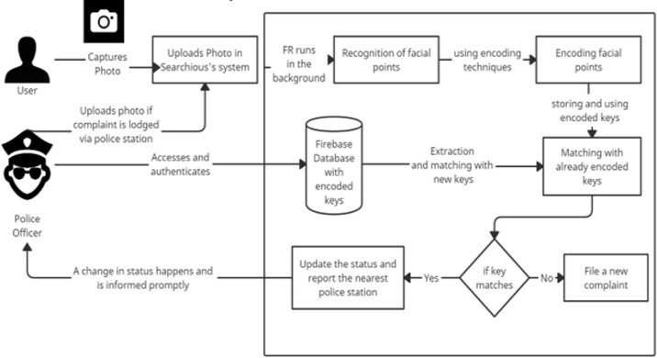
Department of CSE-AI & ML (CSM)
Methodology:-
Users take pictures with this sophisticated framework and upload them to a specific search engine. Modern facial recognition algorithms work behind the scenes. Face net extracts features, MTCNN guarantees accurate face detection, and SVM takes care of classification jobs. By utilizing Facenet's powerful features, these algorithms work together to recognize and extract complex facial landmarks from the supplied picture, producing unique encoding keys for every person.

Slide 17
Department of CSE-AI & ML (CSM)
Ensuring the confidentiality and accuracy of confidential information is a fundamental part of Searchious. This requires ensuring the security of the encrypted face points and associated keys in the Firebase database. A sophisticated storage solution protects against unauthorized access and potential security breaches, assuring users that their confidential data is treated with the utmost care. With the introduction of encryption, an additional layer of security is introduced, increasing the challenge to potential adversaries who wish to compromise the integrity of stored data.
When a user uploads another image, Searchious uses a complex matching procedure that involves comparing the newly generated encryption keys with the keys stored in the database. This advanced matching process helps people pinpoint what contributes to overall system performance. After a positive success, the system seamlessly updates the case and quickly sends a detailed report to the designated police station, simplifying communication and response mechanisms for missing cases. In cases where no match is found, the system ensures comprehensive coverage by immediately sending a new complaint. This proactive approach ensures that all possible leads are investigated and emphasizes the importance of extensive and comprehensive efforts to locate missing persons. With the new appeal, Searchious demonstrates its unwavering commitment to the quest to reunite people and families. Access to the intricate details of the Firebase database, including extracting and combining encryption keys, is an optionally granted privilege that is extended to authorized entities, usually only selected companies. The decision to restrict access is based on the obligation to ensure data security and privacy. These authorized entities go through a rigorous authentication process that reinforces the system's commitment to prevent unauthorized access and potential misuse of sensitive information. This selective approach ensures that only reputable and trusted parties can take advantage of the system and its capabilities, while maintaining the integrity of the Missing Persons Identification Framework.
In search of a technologically advanced, morally sound and efficient missing person detection system, Searchious strategically combines the strengths of cutting-edge algorithms such as Facenet, MTCNN and SVM. This combination of state-of-the-art technologies ensures the system and ability to handle different facial features, adapt to changing conditions and deliver accurate results. The framework and commitment to technological excellence and ethical considerations make Searchious a solid and reliable solution for finding missing persons. .

Slide 18
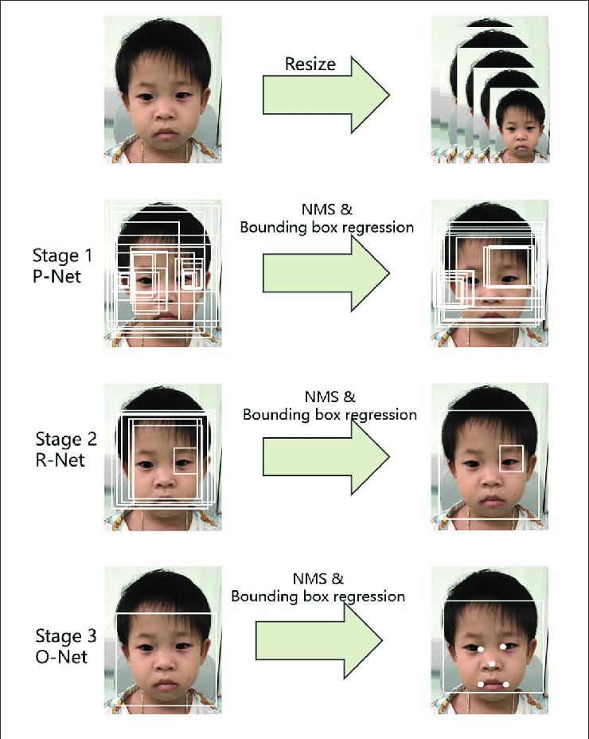
Department of CSE-AI & ML (CSM)
Three-stage multi-task deep convolutional networks are part of the MTCNN cascaded framework pipeline. Firstly, candidate windows are formed by a rapid Proposal Network (P-Net). Following that, we use a Refinement Network (RNet) in the following stage to further hone these candidates. The final bounding box is produced by the Output Network (O-Net) in the third stage.
Facenet:-
The FaceNet model employs a deep neural network architecture known as a Siamese network. Siamese networks consist of twin neural networks with shared parameters, and they are trained to minimize the distance between embeddings of the same person's face while maximizing the distance between embeddings of different individuals. This training approach allows FaceNet to produce highly discriminative facial features, making it particularly effective for face recognition tasks.
Support Vector Machine :-
Polynomial kernel SVM is a kind of SVM in which the input data is transformed into a higher dimensional space using a polynomial function. The polynomial kernel function raises the result to a power determined by the function's degree parameter after adding a constant to the dot product of the input data points. A collection of new features that represent the non-linear interactions between the input data are the outcome of this transformation.

Slide 19
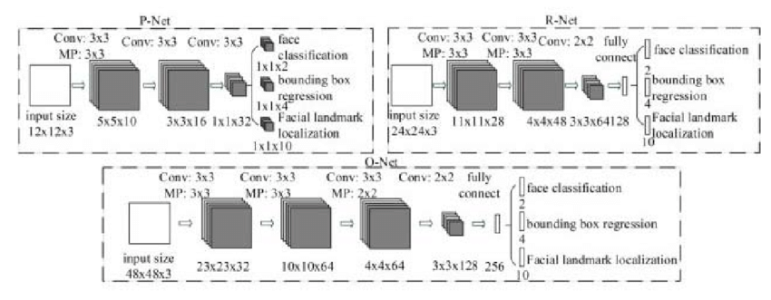
Department of CSE-AI & ML (CSM)
MTCNN :-
MTCNN stands out as a sophisticated deep cascaded multi-task architecture, capitalizing on the natural correlation between alignment and detection to enhance overall performance. This framework adopts a cascaded structure, incorporating three meticulously crafted layers of deep convolutional networks to predict both face and landmark placement in a progressive coarse-to-fine fashion.
Convolutional Neural Networks (CNNs) are a category of deep learning models specifically tailored for tasks utilizing visual input, such object detection and image recognition. CNNs are made up of layers that carry out several tasks, including fully linked layers, pooling, and convolution. With the ability to learn hierarchical representations of characteristics from incoming data, these networks are highly suitable for tasks involving spatial connections, such image processing.
Figure:- The architecture of P-Net, R-Net, and O-Net is characterized by specific components denoted as "MP" for max pooling and "Conv" for convolution.

Slide 20
Department of CSE-AI & ML (CSM)
P-Net (Proposal Network): An essential part of the widely used Single Shot Multibox Detector (SSD) object detection framework is P-Net. P-Net is responsible for creating region suggestions or bounding boxes around probable items inside an image. It finds regions of the input picture that potentially contain objects by using a collection of convolutional layers to scan the image at different sizes. Bounding box suggestions and confidence scores are generated by P-Net for subsequent processing.
R-Net (Refinement Network): Following P-Net in the SSD pipeline, R-Net refines the bounding box proposals provided by P-Net. It performs more accurate localization and classification of objects within the proposed regions. R-Net employs additional convolutional layers to enhance the precision of the bounding box predictions. The refined proposals are then passed to the subsequent stage for further improvement.
O-Net (Output Network): O-Net is the final stage in the SSD architecture. Its primary role is to perform detailed object classification and facial landmark localization. O-Net fine-tunes the bounding box proposals from the previous stages and provides the final predictions, including object class labels and precise facial landmark coordinates. This network is crucial for achieving high accuracy in tasks that require detailed localization, such as facial recognition.

Slide 21

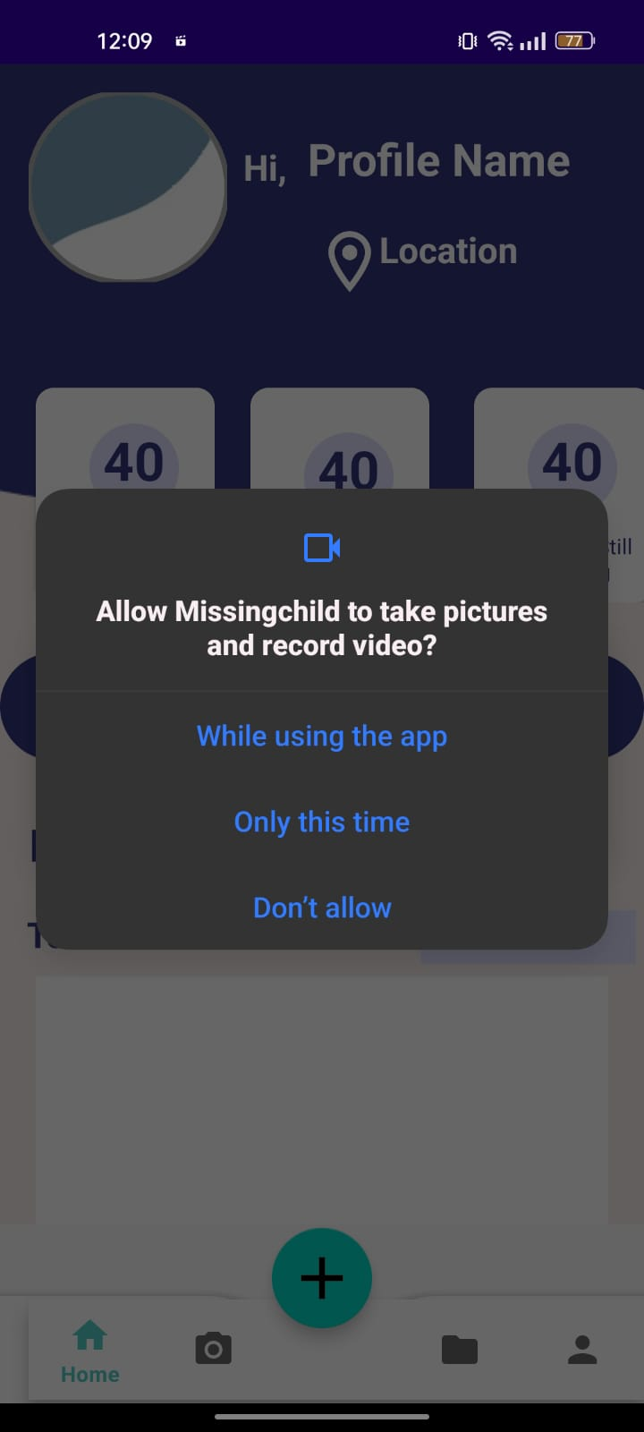
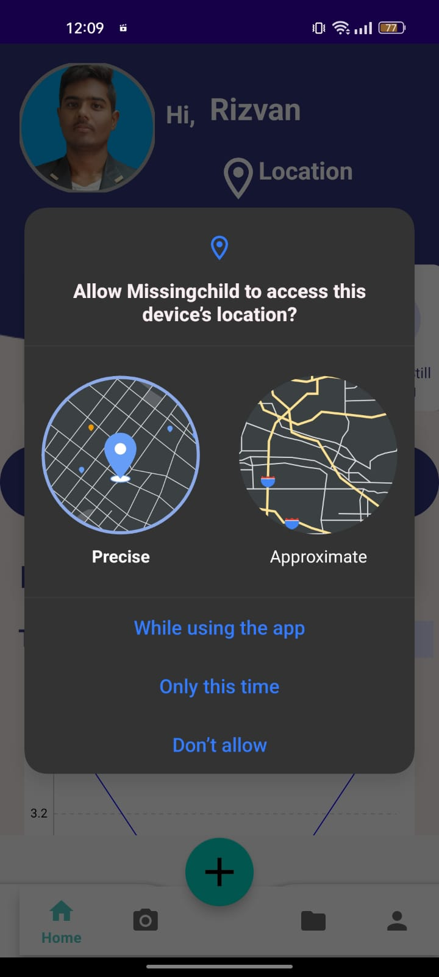
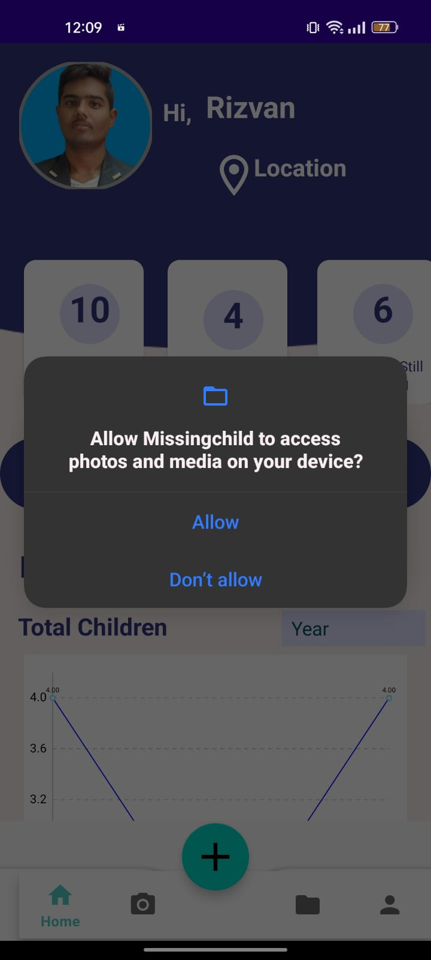

Department of CSE-AI & ML (CSM)
App Working:-
a) Welcome Page:- The Welcome Page serves as the initial point of interaction for users entering the Missing Child Locator app. This screen is strategically designed to create a positive and user-friendly first impression. It typically features a visually appealing layout, introducing users to the app's purpose and functionality. The Welcome Page may include a brief overview of the app's mission, along with captivating images or graphics to convey the importance of the cause. Additionally, the Welcome Page often includes a prominent call-to-action, guiding users to either log in or sign up to access the full range of features offered by the app.
b) Login Page:-
The Login Page is a critical component of the app, where users with existing accounts can securely access their profiles. This screen typically includes fields for users to input their credentials, such as username or email and password. Security features, like password encryption, may be implemented to ensure the protection of user data. Additionally, the Login Page might incorporate options for users to recover forgotten passwords or access support if needed. The design of this screen prioritizes simplicity and efficiency to provide a seamless entry point for users returning to the app.

Slide 22
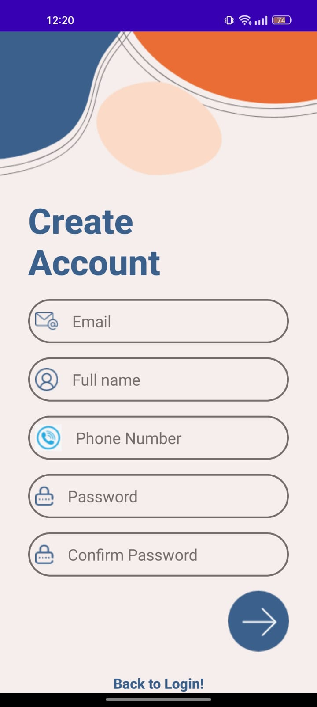
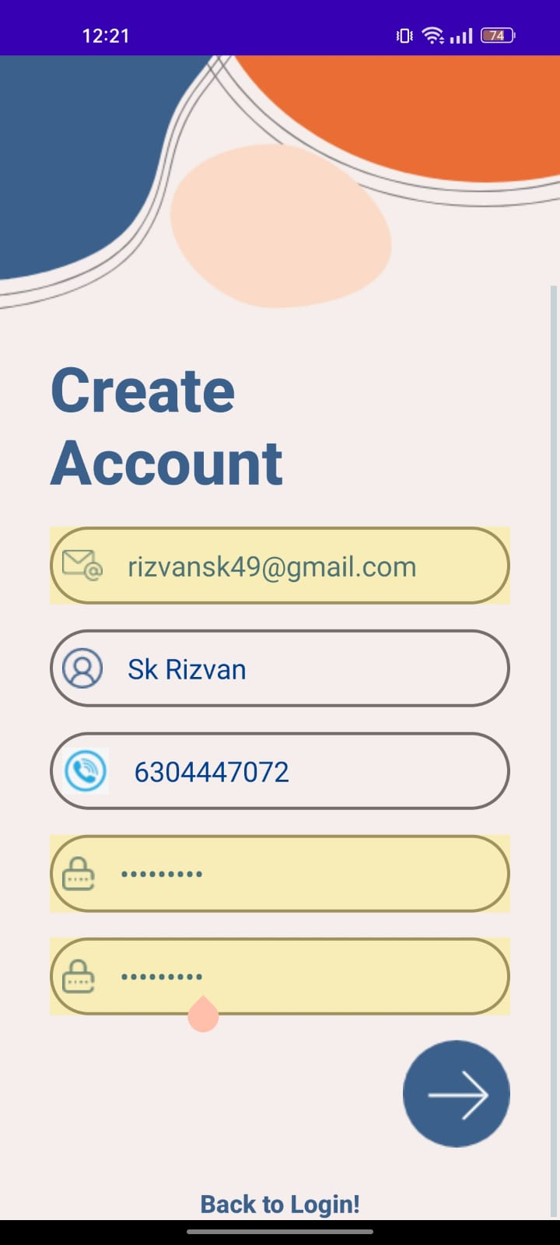
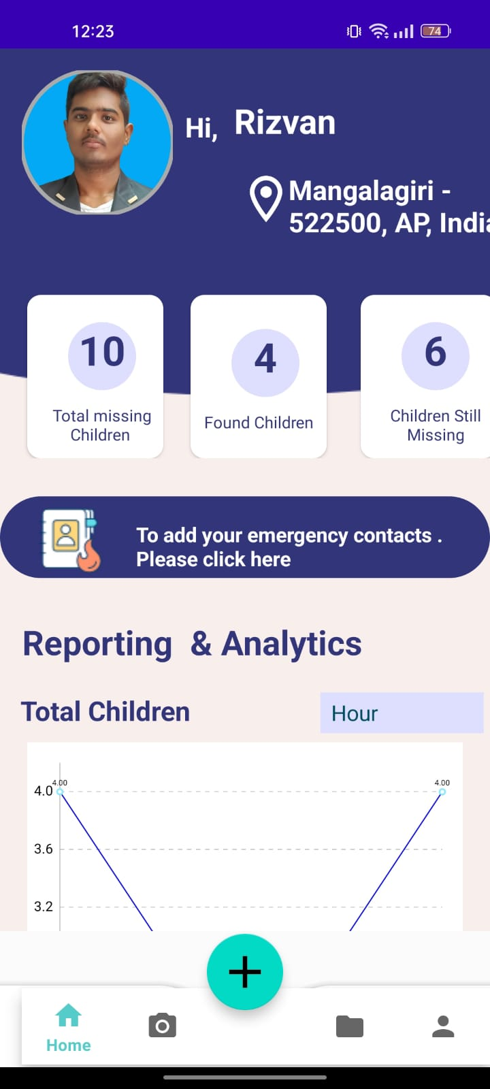
Department of CSE-AI & ML (CSM)
c) Sign Up page:
The Sign Up Page plays a pivotal role in onboarding new users to the Missing Child Locator app. This screen prompts users to create accounts by filling out a registration form. The form may include fields for essential information such as name, email address, and password. To enhance user engagement, the Sign Up Page could also incorporate informative tooltips or guidance to explain the importance of accurate information. The design aims to be intuitive and user-friendly, facilitating a smooth registration process for individuals who are joining the app for the first time.
d) Home Page:
The Home Page is the central hub of the Missing Child Locator app, where users access key features and information. This screen typically displays a map interface showcasing the user's current location or a chosen region. It may highlight recent alerts or missing child cases, enabling users to stay informed about ongoing situations. The Home Page might also include search functionalities, allowing users to customize their view based on specific criteria such as location, age, or other relevant parameters. Intuitive navigation elements and quick access to essential features contribute to an efficient and user-centric Home Page design..

Slide 23
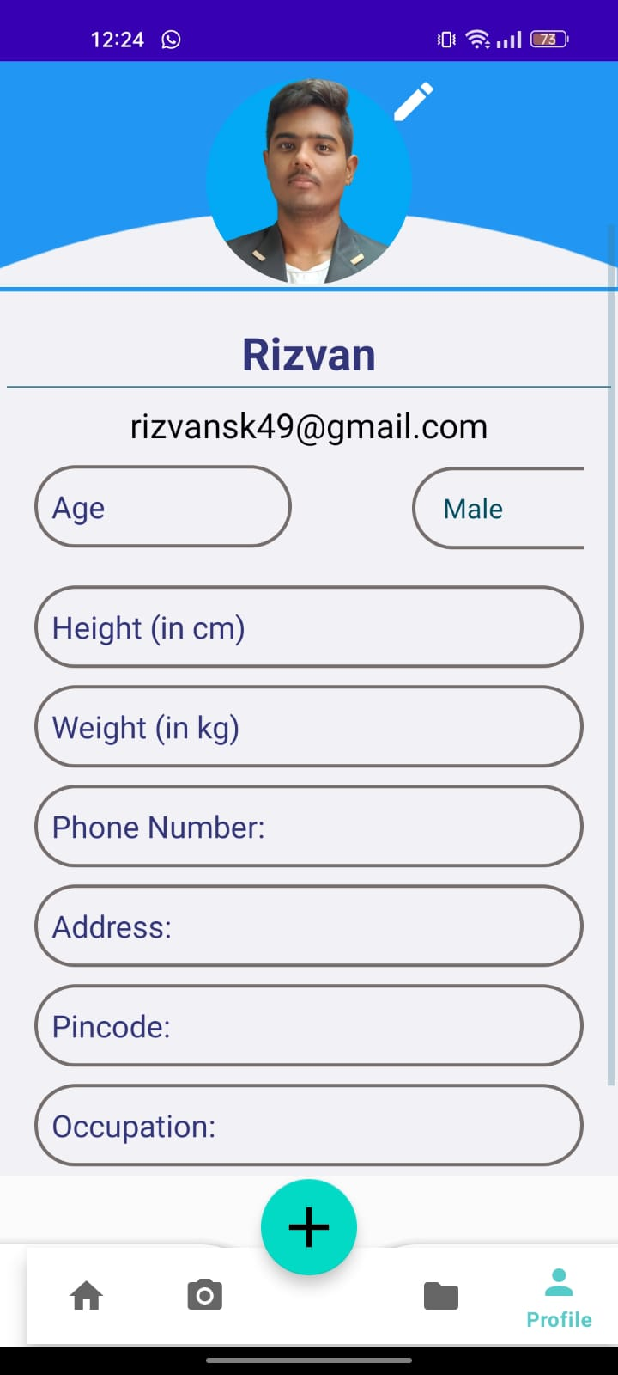
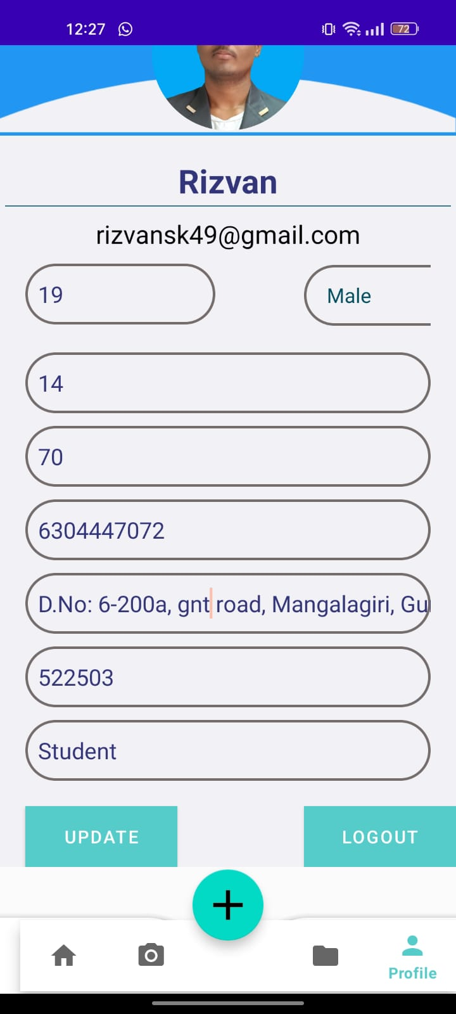
Department of CSE-AI & ML (CSM)
e) Profile page:-
The Profile Page is a personalized space within the app where users can manage their account settings and view relevant information. This screen typically displays the user's profile picture, name, and other details. Users can update their profile information, change account settings, and review their activity history on this page. Additionally, the Profile Page may include options for users to link or update emergency contact information, enhancing the app's functionality as a comprehensive missing child locator tool. The design prioritizes clarity and ease of use, ensuring that users can effortlessly manage their profiles and preferences within the app.
f) Logout page:-
The Logout Page serves as the exit point for users who wish to securely sign out from the Missing Child Locator app. This screen is designed to confirm the user's decision to log out, often featuring a prompt or message confirming the successful logout. It may also include additional options, such as the ability to return to the Welcome Page or provide feedback on the app. The Logout Page prioritizes user security by ensuring that all active sessions and sensitive information are appropriately terminated upon logout.

Slide 24
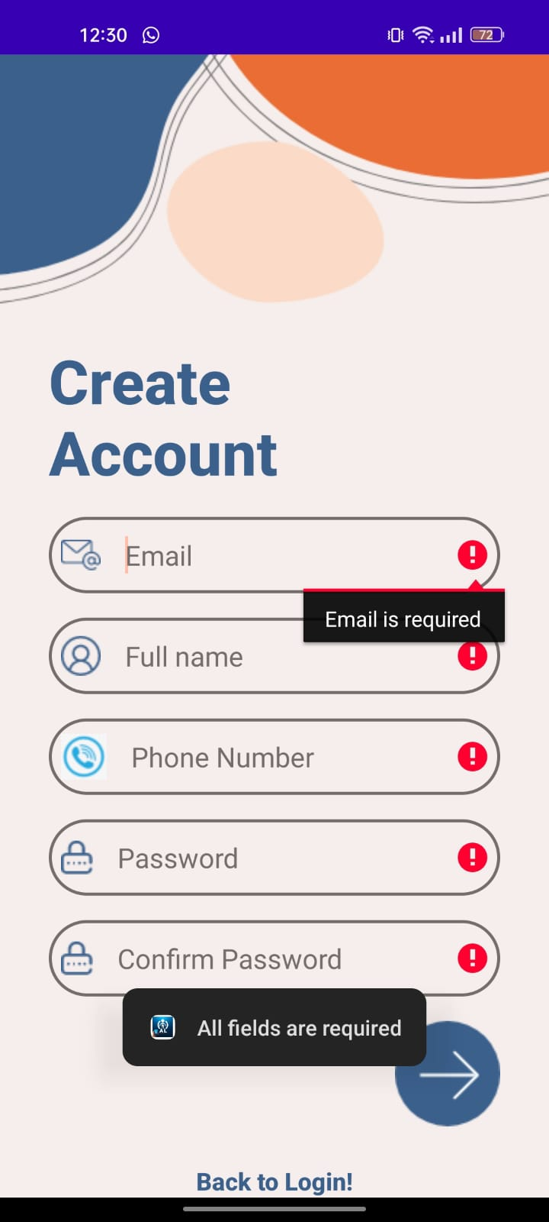
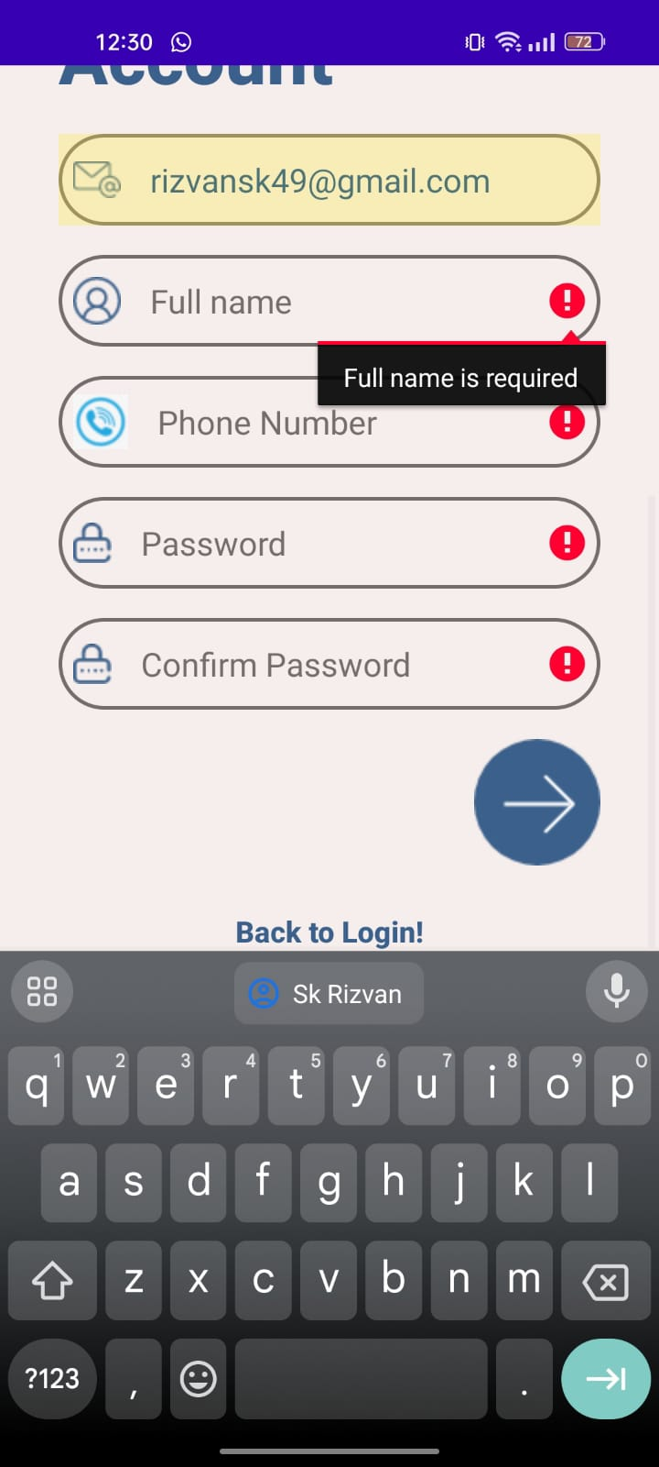
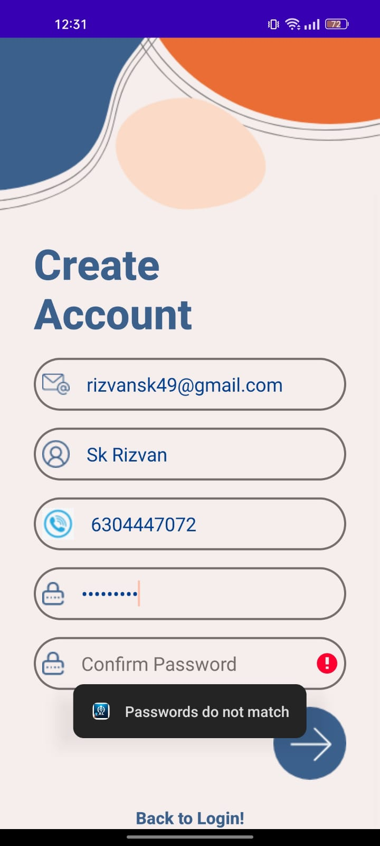
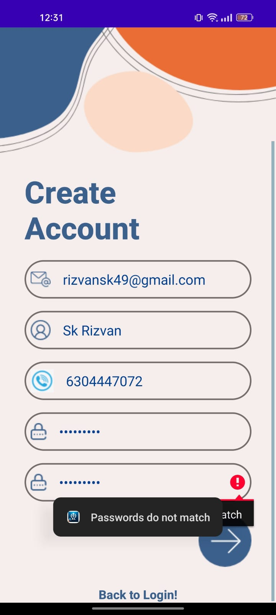
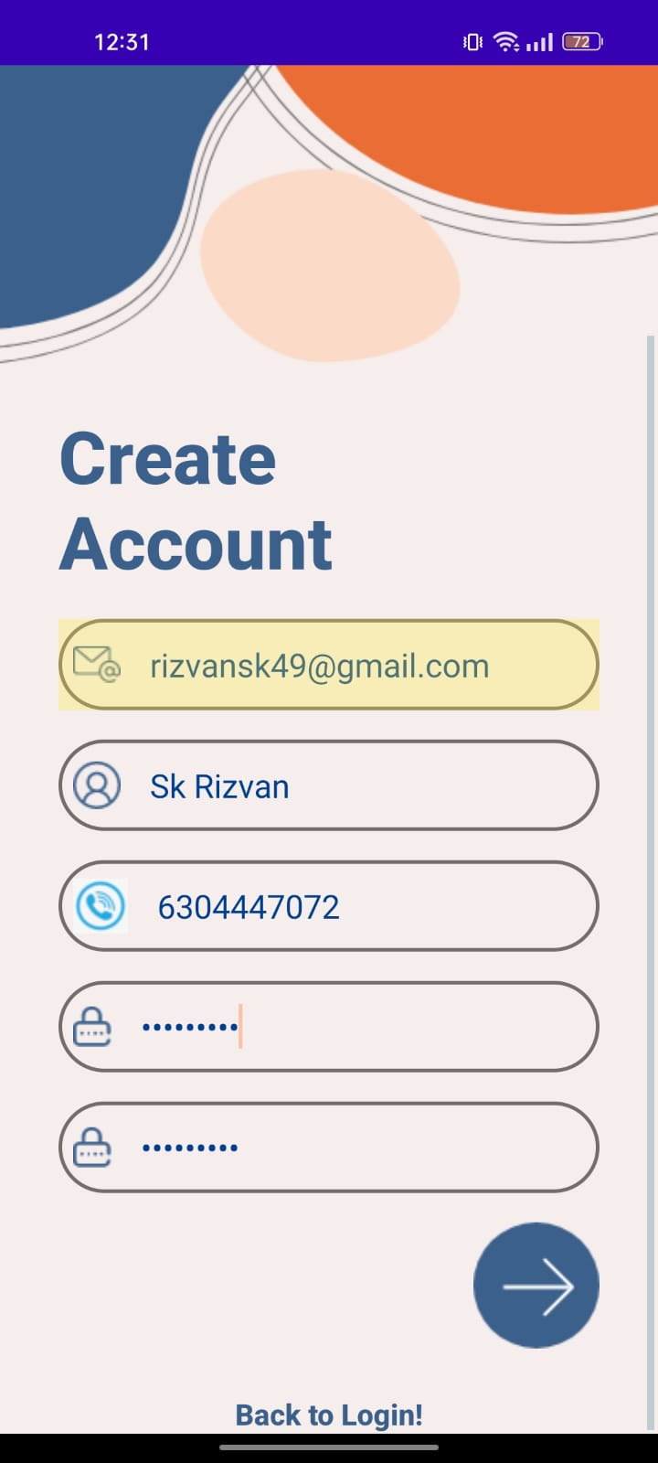



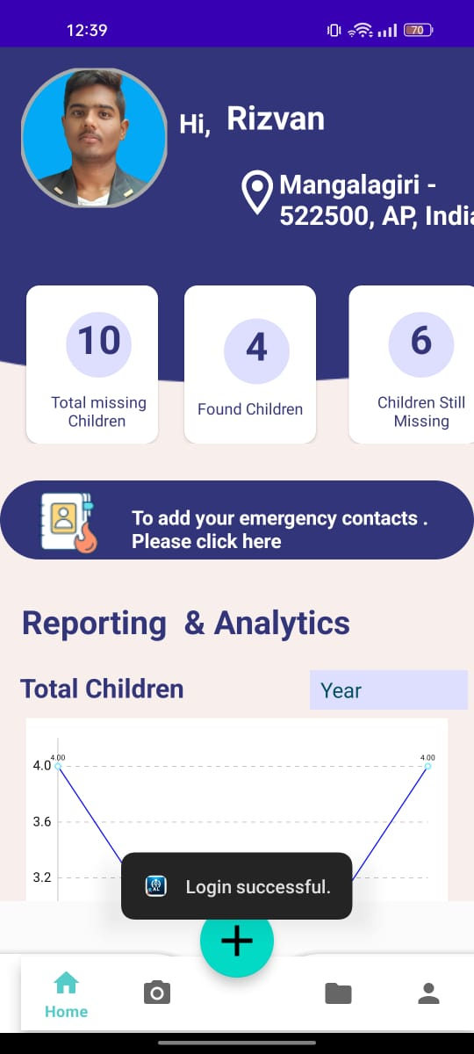
Department of CSE-AI & ML (CSM)
FR1:- User Registration and Authentication:
User registration and authentication are foundational components of the Missing Child Locator app, ensuring a secure and personalized experience for users. The registration process, facilitated through a dedicated Sign Up Page, involves users providing essential details such as their name, email address, and a secure password. Authentication mechanisms, including password encryption, are implemented to safeguard user information. Upon successful registration, users can log in securely through the Login Page, where their credentials are verified. This robust registration and authentication system not only establishes user identities but also lays the groundwork for users to access critical features, contribute to the community, and engage in the app's mission to locate missing children. The seamless integration of these processes enhances overall user trust and security within the application.

Slide 25
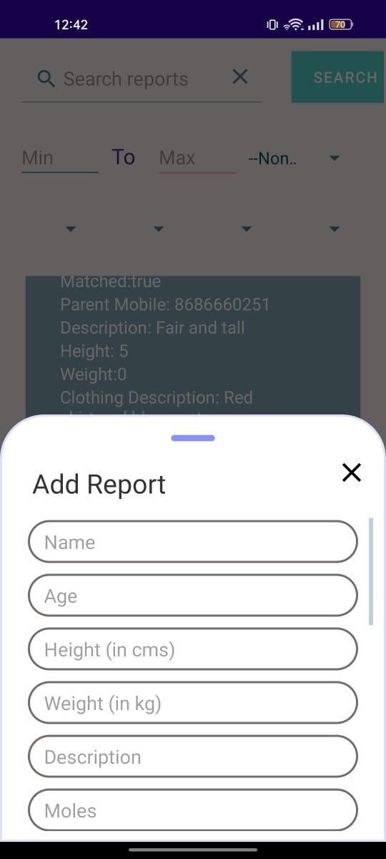
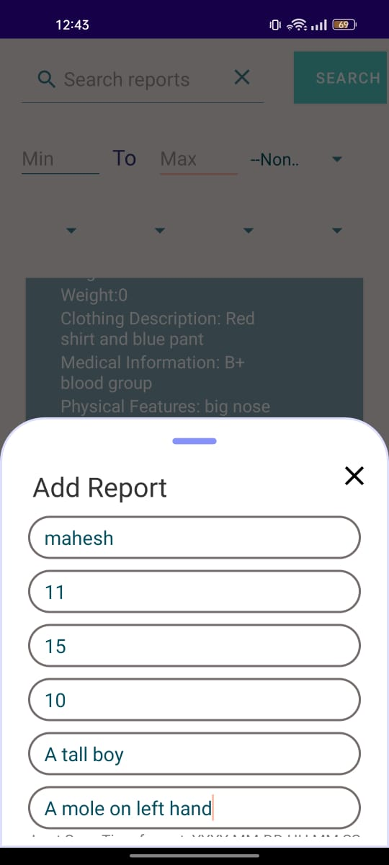
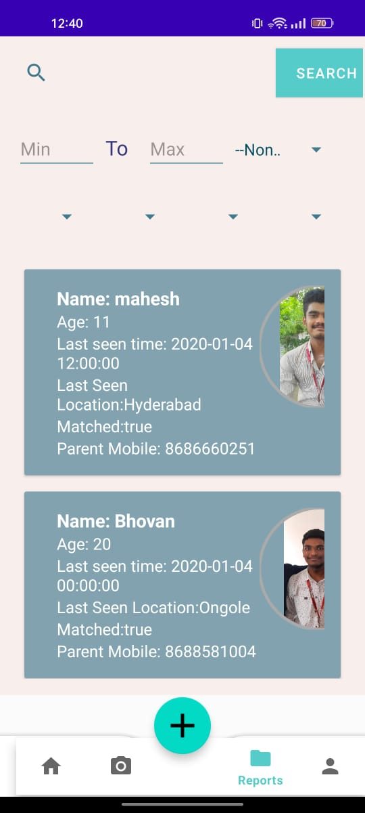
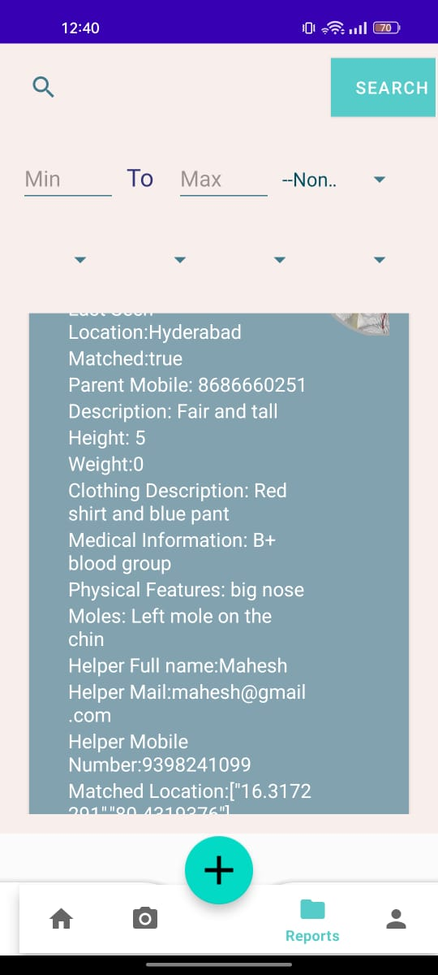
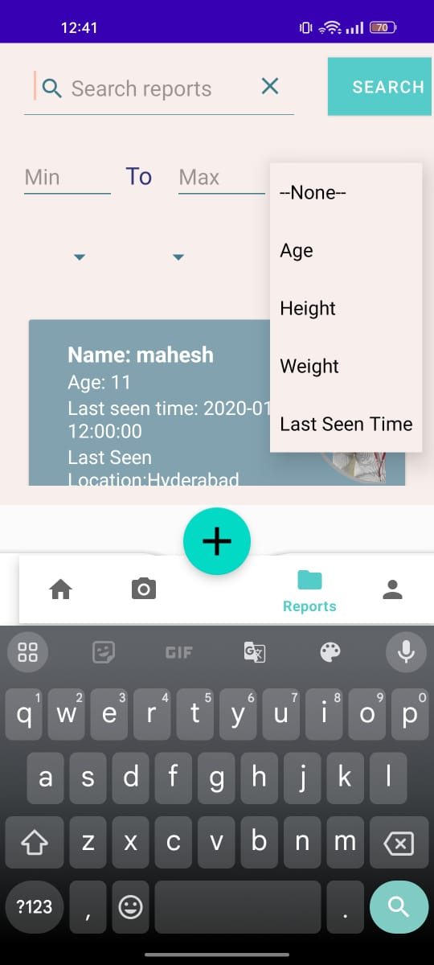
Department of CSE-AI & ML (CSM)
FR2:- Missing Child Report Submission :
The Missing Child Locator app empowers users to contribute actively to its mission through the seamless process of missing child report submission. Accessed via a dedicated reporting interface, users can provide crucial details such as the child's name, age, last known location, and relevant images. The submission form may also include additional information, ensuring comprehensive and accurate reporting. The app's intuitive design facilitates a user-friendly experience, guiding individuals through the process while encouraging the inclusion of pertinent details. By fostering community engagement and prompt reporting, this feature plays a pivotal role in the app's collective efforts to swiftly and effectively address cases of missing children.

Slide 26
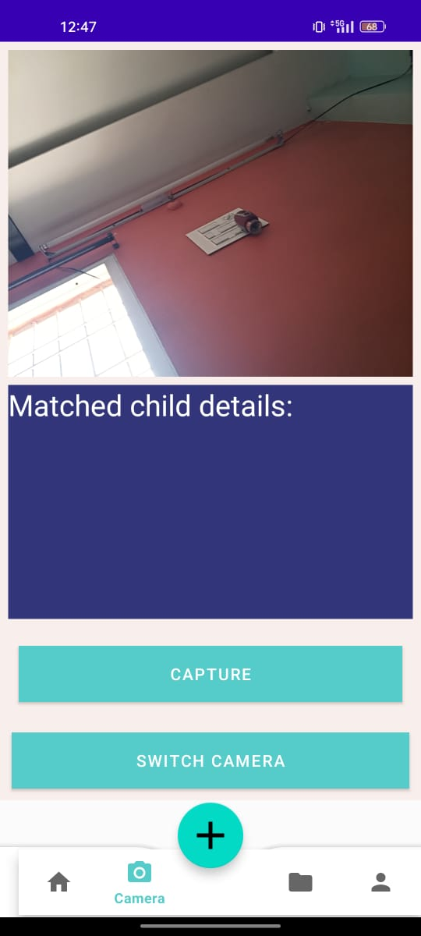
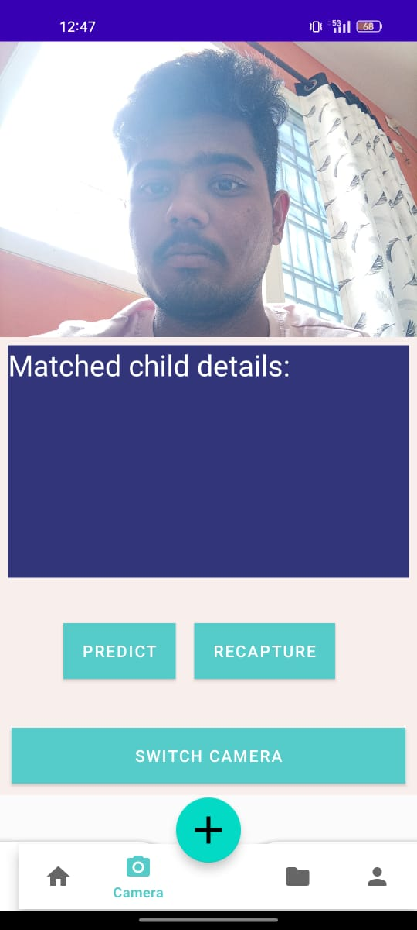
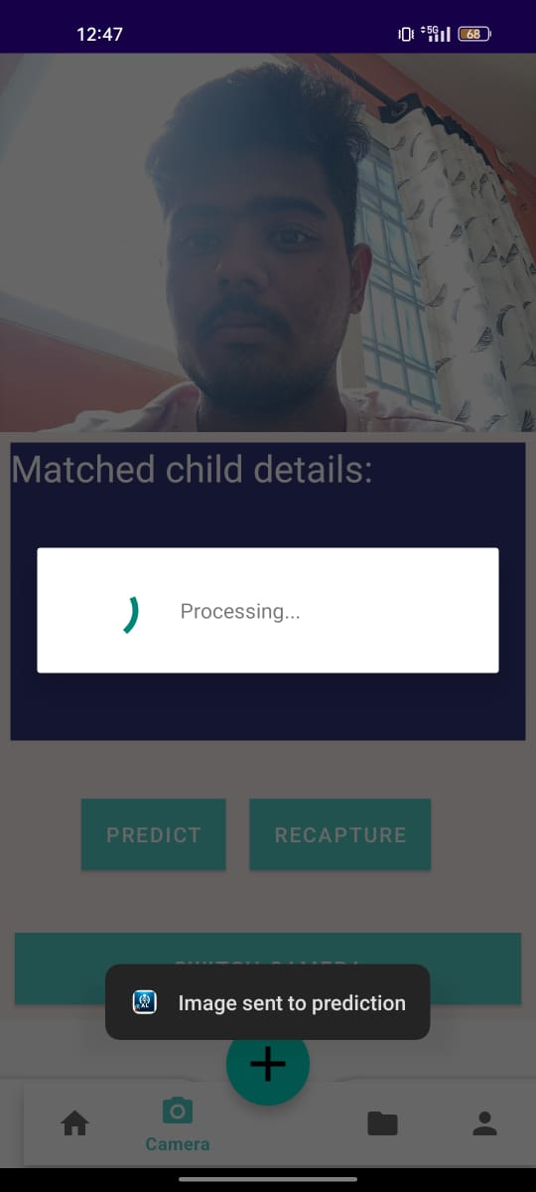
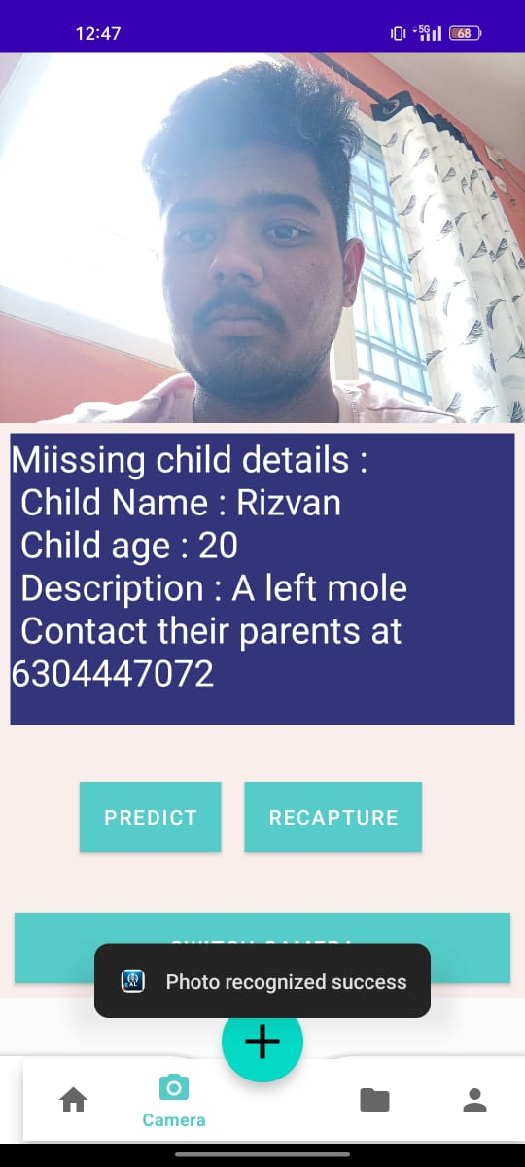
Department of CSE-AI & ML (CSM)
FR3:-Facial Recognition Matching:
The Facial Recognition Matching feature within the Missing Child Locator app harnesses state-of-the-art algorithms, including MTCNN for precise face detection and Facenet for feature extraction, to compare submitted facial images with existing profiles. This technology enables the app to generate unique facial encodings, facilitating accurate matching and identification. Leveraging the power of SVM for classification, the system efficiently analyzes facial points, ensuring robust and reliable matching capabilities. Users benefit from a swift and reliable process that aids in reuniting missing children with their families. The implementation of Facial Recognition Matching underscores the app's commitment to employing advanced technologies for the greater purpose of locating and ensuring the well-being of missing children.

Slide 27
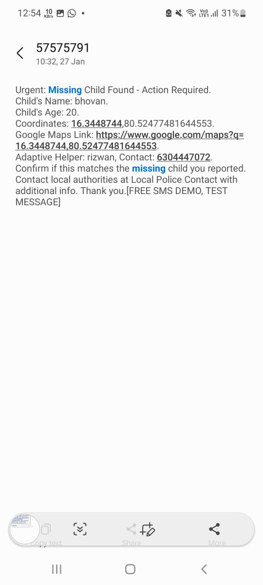
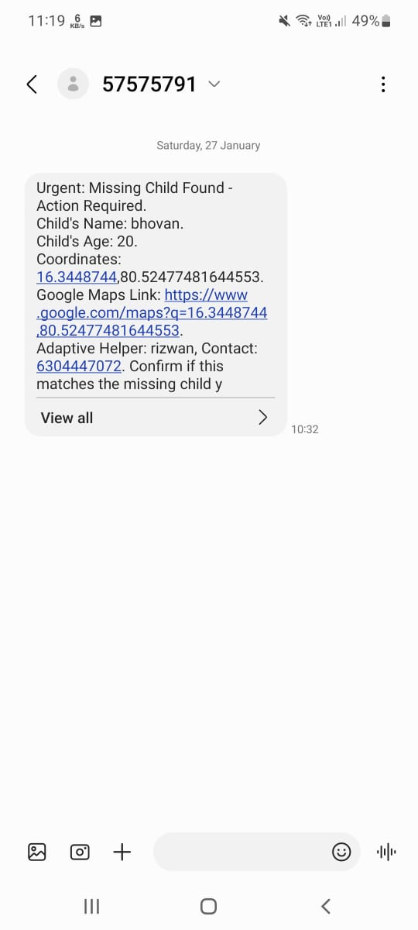
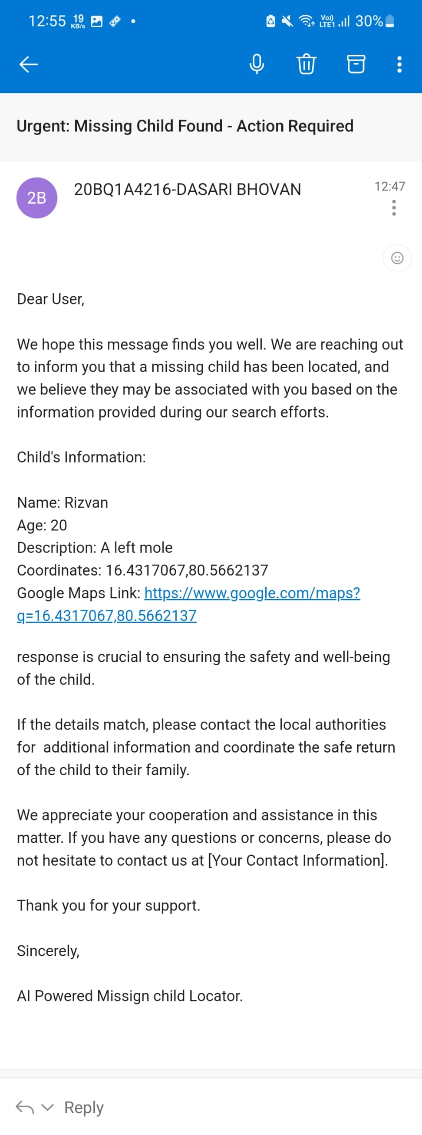
Department of CSE-AI & ML (CSM)
FR4:- Real Time Notifications:
The Missing Child Locator app prioritizes timely communication through its Real-Time Notifications feature, employing SMS and email channels. Once a missing child report is submitted or a significant update occurs, the system promptly triggers notifications to alert users. This ensures that community members and authorities stay informed in real-time, fostering a swift and collaborative response. The integration of SMS and email notifications enhances the app's reach, ensuring that critical information reaches users efficiently, even if they are not actively using the application. This proactive approach underscores the app's commitment to leveraging diverse communication channels for effective and immediate response in locating missing children.

Slide 28
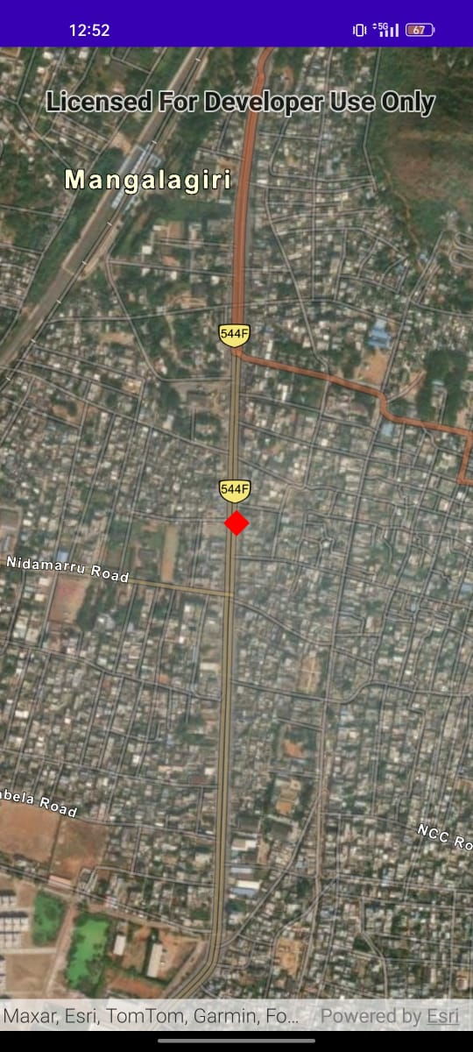
Department of CSE-AI & ML (CSM)
FR5:- Interactive Map Display:
The Interactive Map Display in the Missing Child Locator app plays a pivotal role in visualizing and responding to missing child incidents. Whether triggered by an SMS or email notification or during the process of submitting a missing child report, this feature dynamically renders a map interface. Users can pinpoint locations related to the missing child, enhancing the spatial understanding of the situation. Additionally, when users capture images for a missing child report, the system may predict and display potential locations based on geotagging or visual cues. This interactive map functionality not only assists users in reporting and understanding incidents more comprehensively but also aids in coordinating swift responses from the community and authorities, ultimately contributing to the app's mission of reuniting missing children with their families.

Slide 29
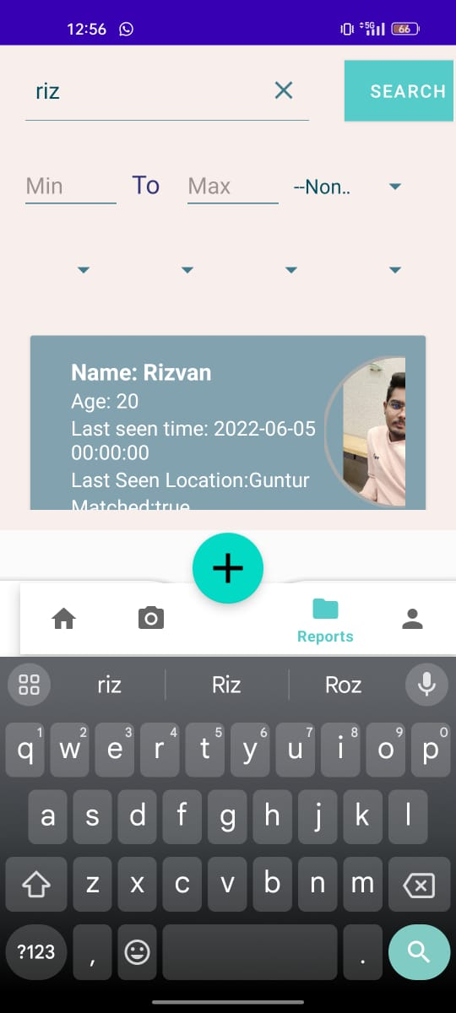
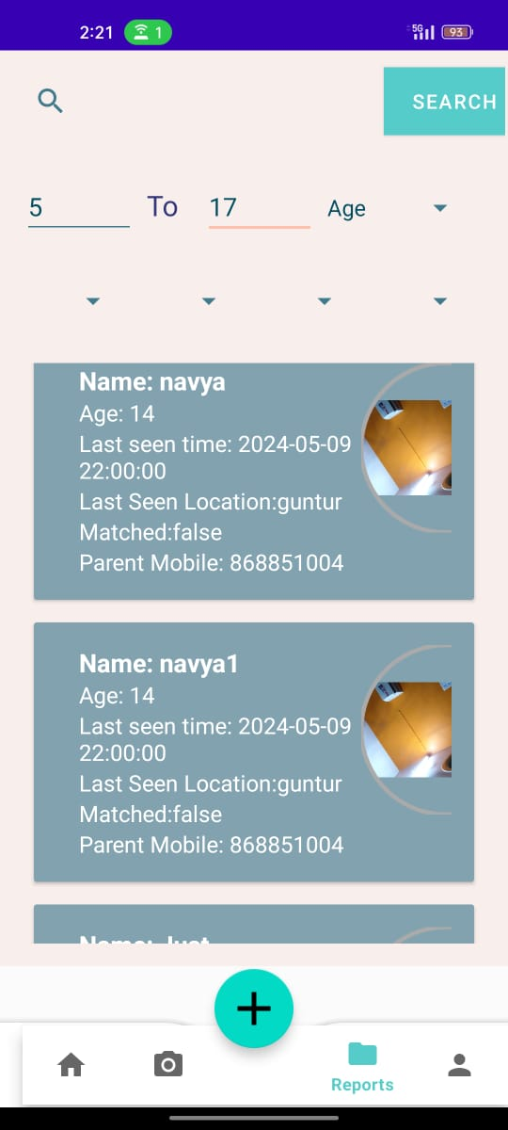
Department of CSE-AI & ML (CSM)
FR6:- Search and Filter Functionality:
The Missing Child Locator app prioritizes user convenience through robust Search and Filter functionalities. Users can efficiently navigate and locate information by employing intuitive search parameters, such as location, age, or specific characteristics. This feature empowers users to tailor their searches, ensuring a focused and relevant outcome. The inclusion of filters enhances the precision of results, enabling users to streamline their efforts when exploring missing child cases or updating information. Whether searching for a specific child or refining results based on specific criteria, the app's Search and Filter functionality provides a user-friendly experience, facilitating quick and targeted access to critical information within the application.

Slide 30
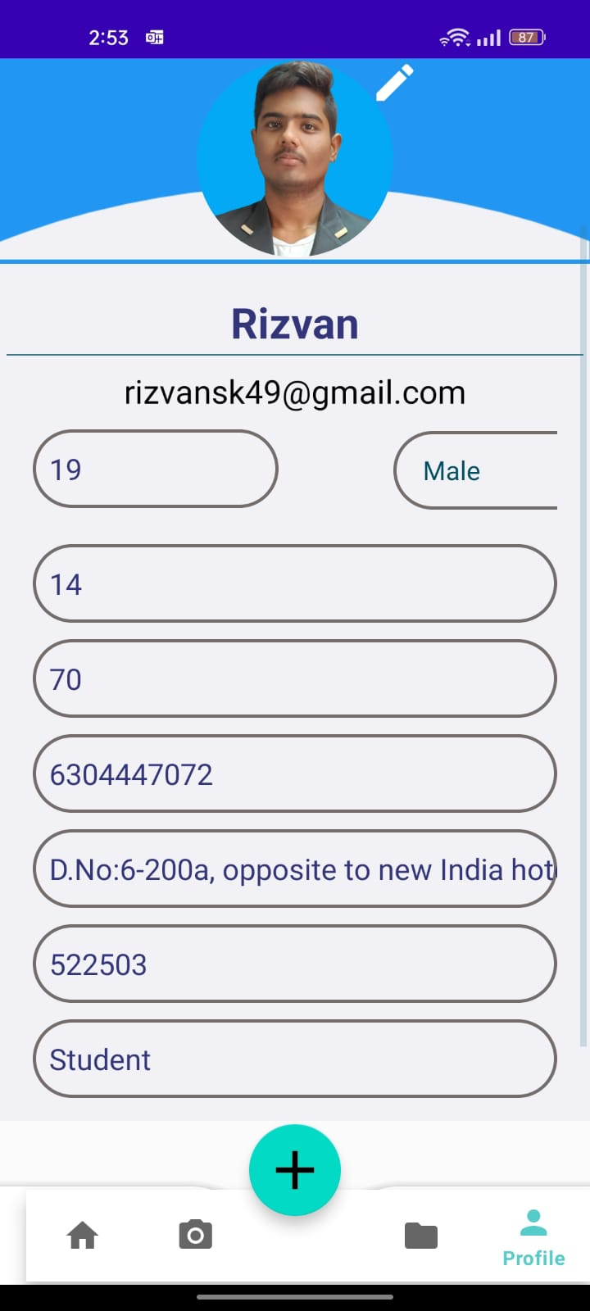
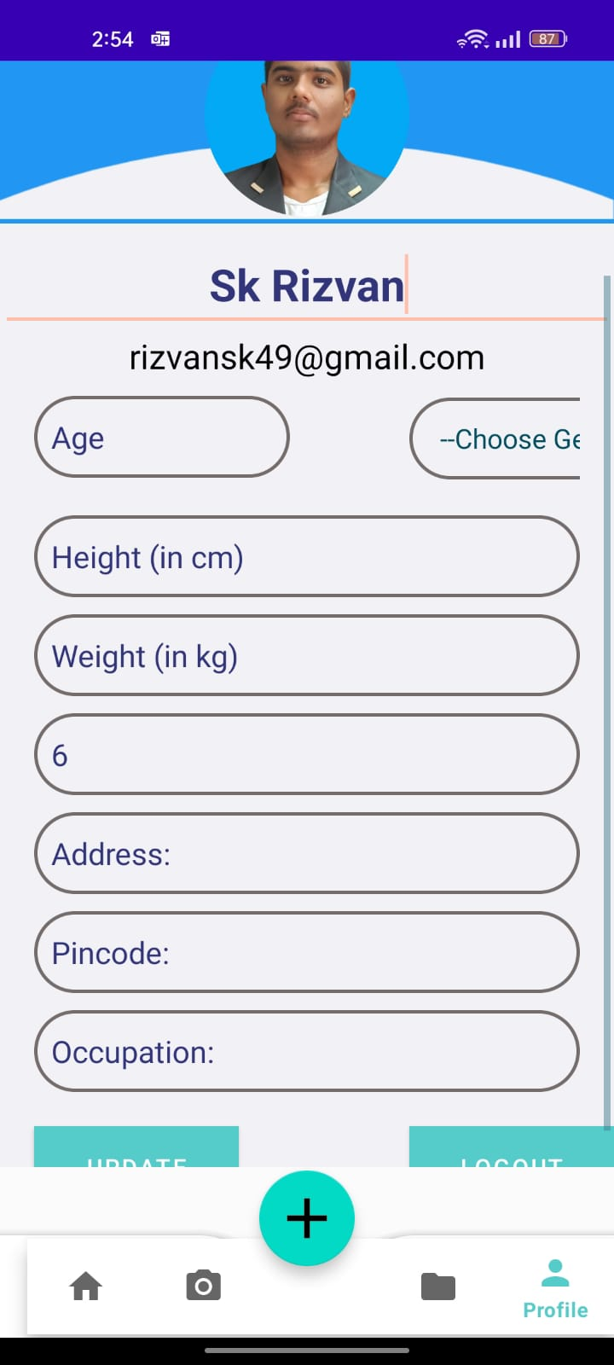
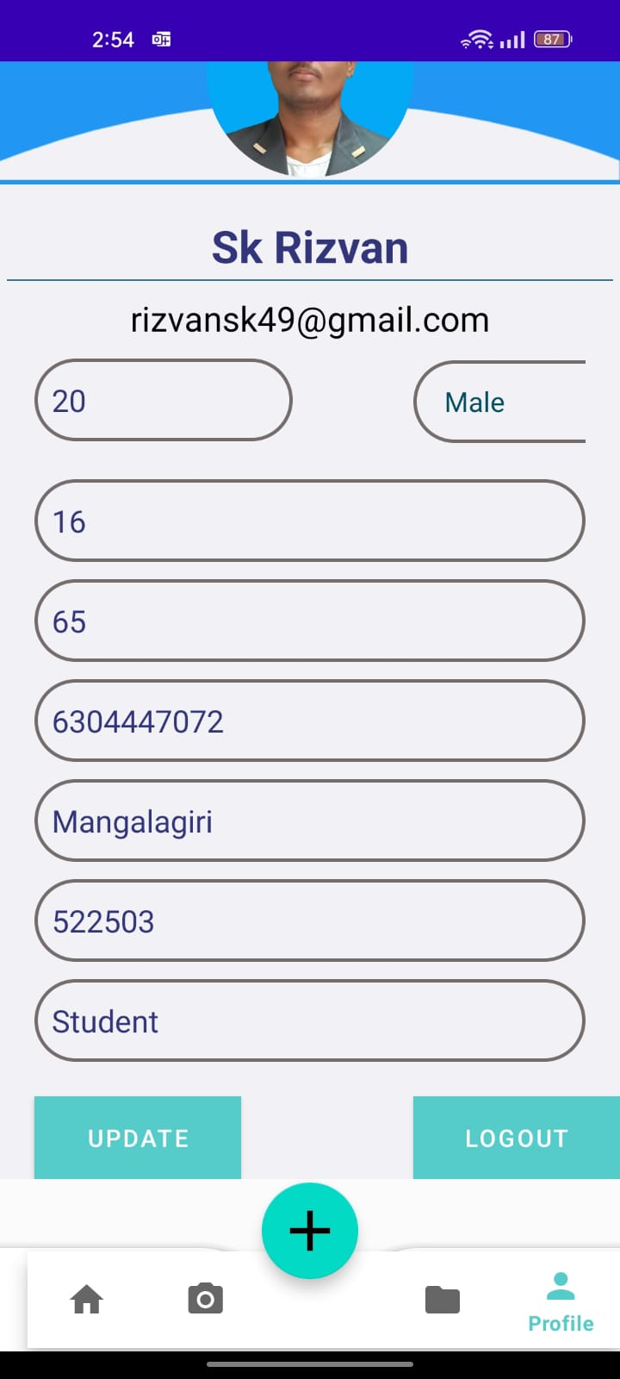
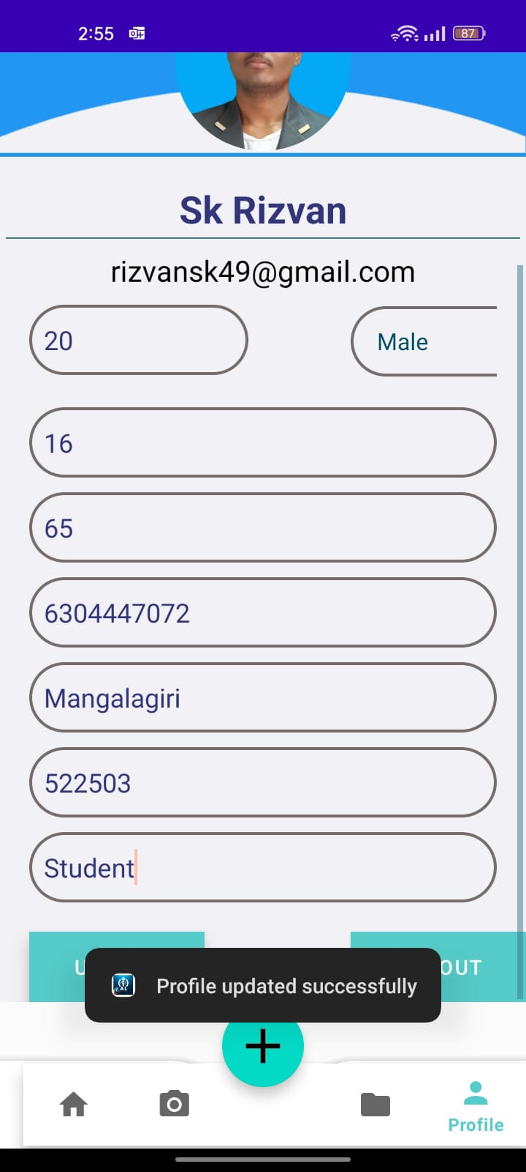
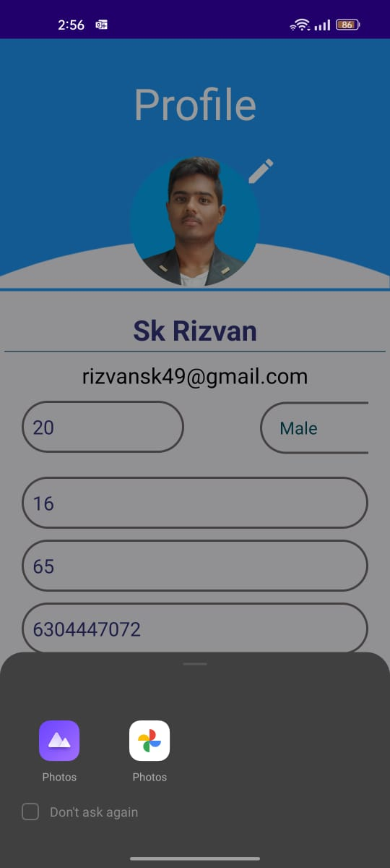
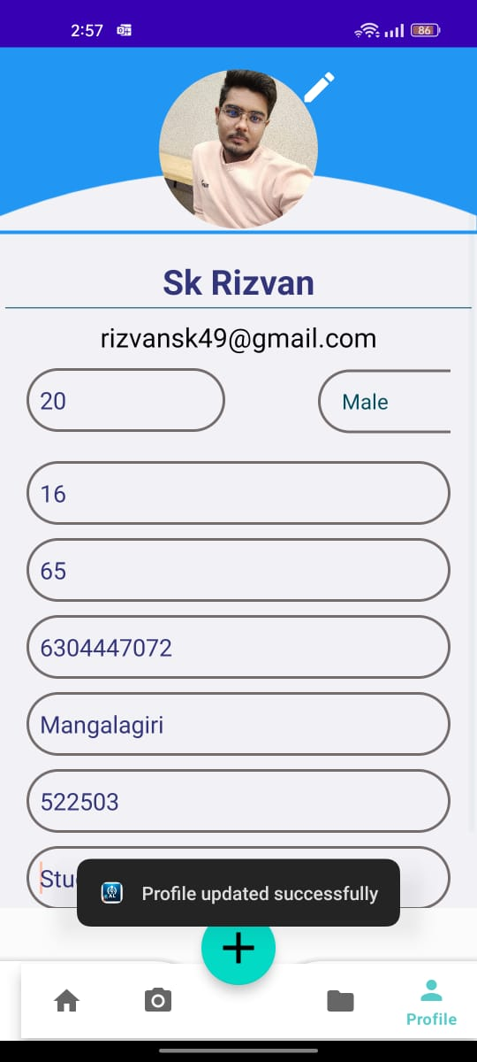
Department of CSE-AI & ML (CSM)
FR7:- Profile Management :
Profile management within the Missing Child Locator app is designed for user empowerment and customization. Accessed through a dedicated Profile Page, users can easily view and modify their personal details, including profile pictures and account settings. This feature enables users to update contact information, enhance security settings, and personalize their profiles according to their preferences. The intuitive design prioritizes user control, fostering a seamless experience for individuals who can efficiently manage their profiles and stay engaged with the app's functionalities. Additionally, the Profile Management feature may offer options for users to link emergency contact information, further enhancing the app's role as a comprehensive tool for community involvement and child safety.

Slide 31
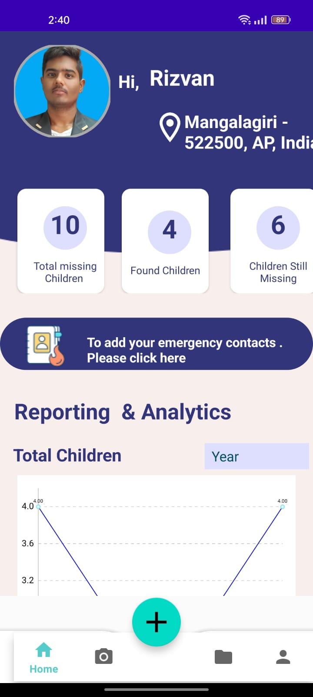
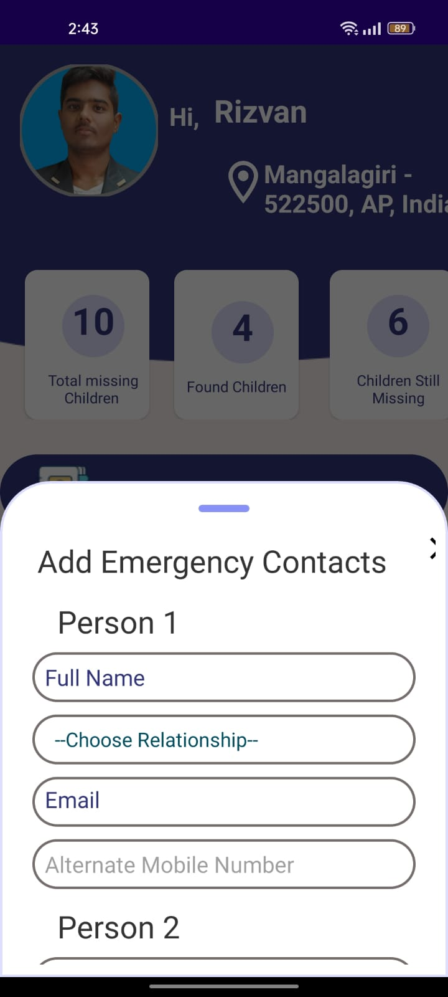
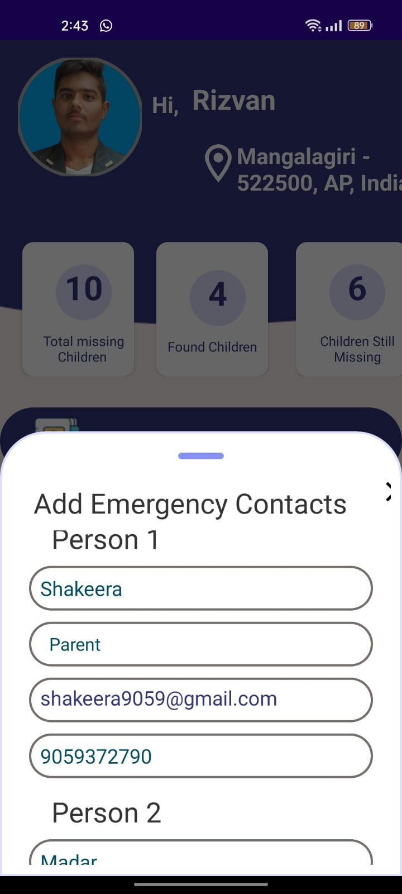
Department of CSE-AI & ML (CSM)
FR8:- Emergency Contact Integration:
The Missing Child Locator app incorporates a vital Emergency Contacts Integration feature to enhance user safety and community response. Users can seamlessly link and update emergency contact information directly within their profiles. This integration ensures that, in critical situations, authorities and designated contacts can be swiftly informed. The intuitive design enables users to manage and verify their emergency contacts, reinforcing the app's commitment to proactive measures in ensuring the well-being of missing children. By seamlessly integrating emergency contacts into the user's profile, the app contributes to a comprehensive safety framework, fostering a sense of community responsibility and quick response in times of need.

Slide 32
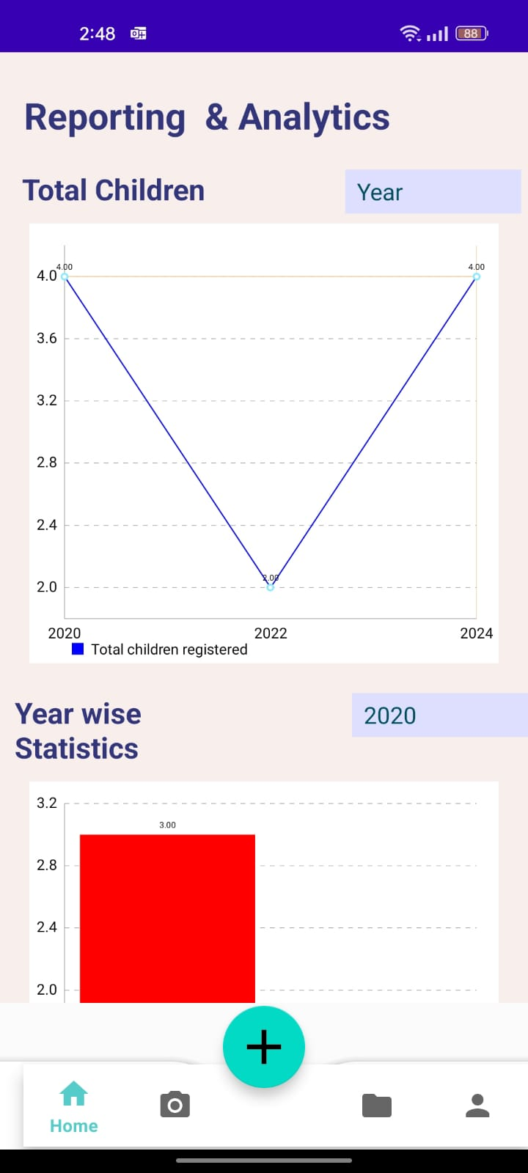
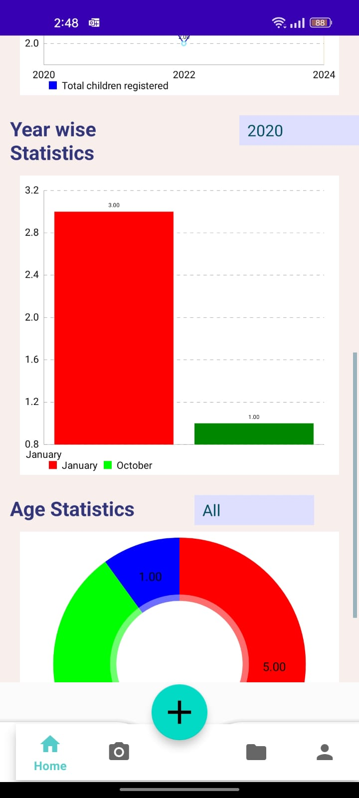
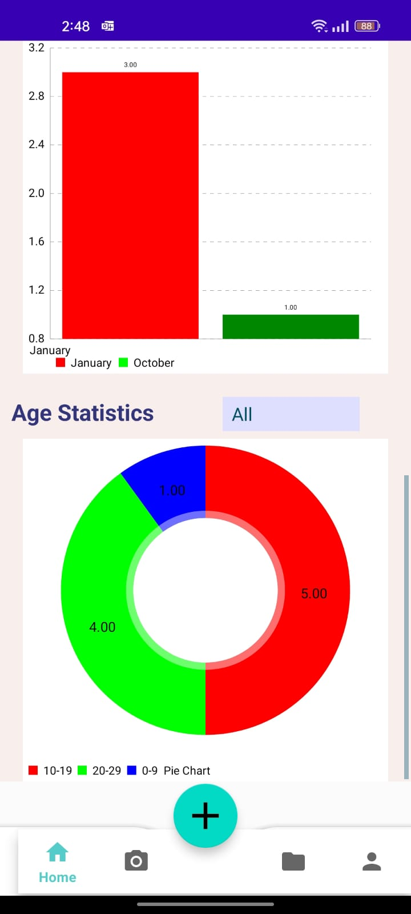
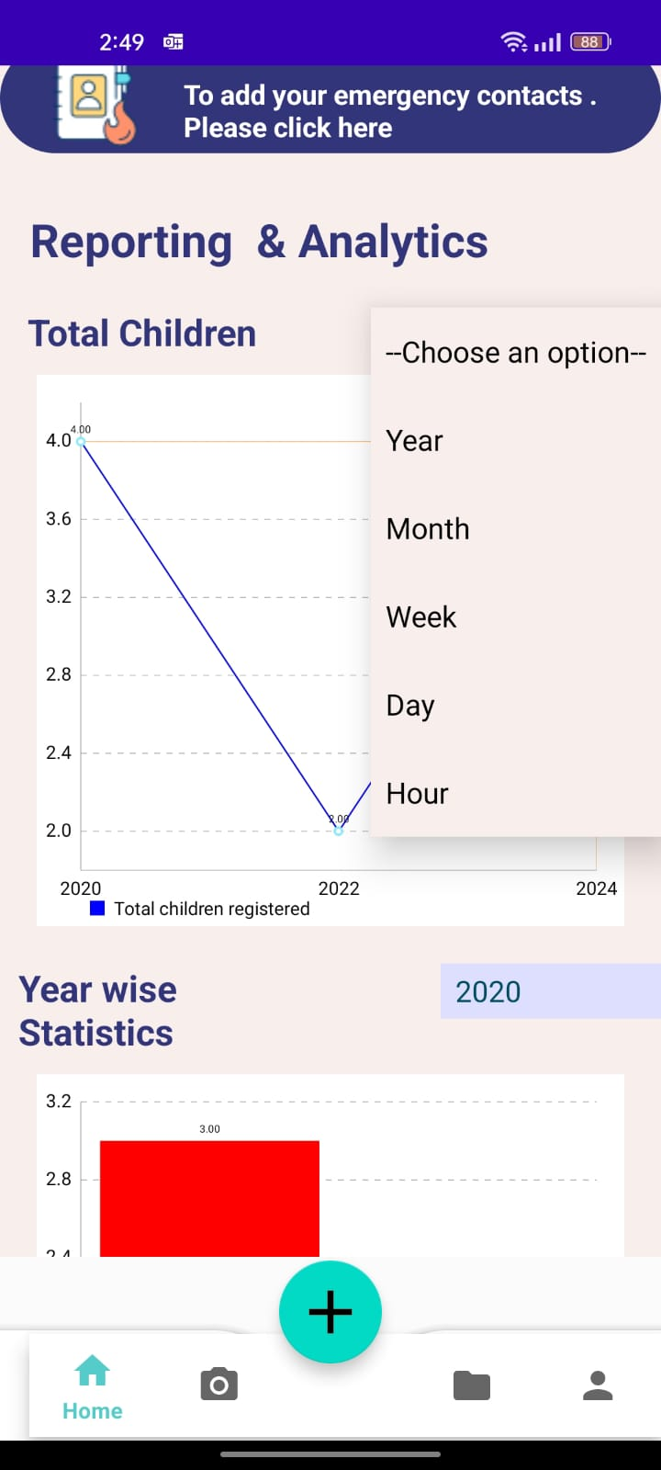
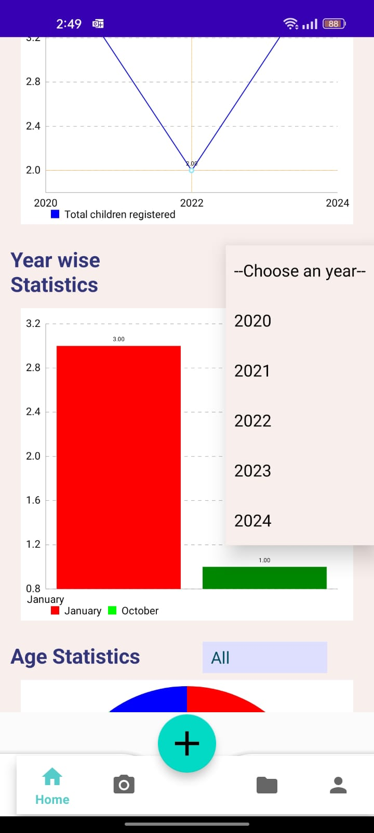
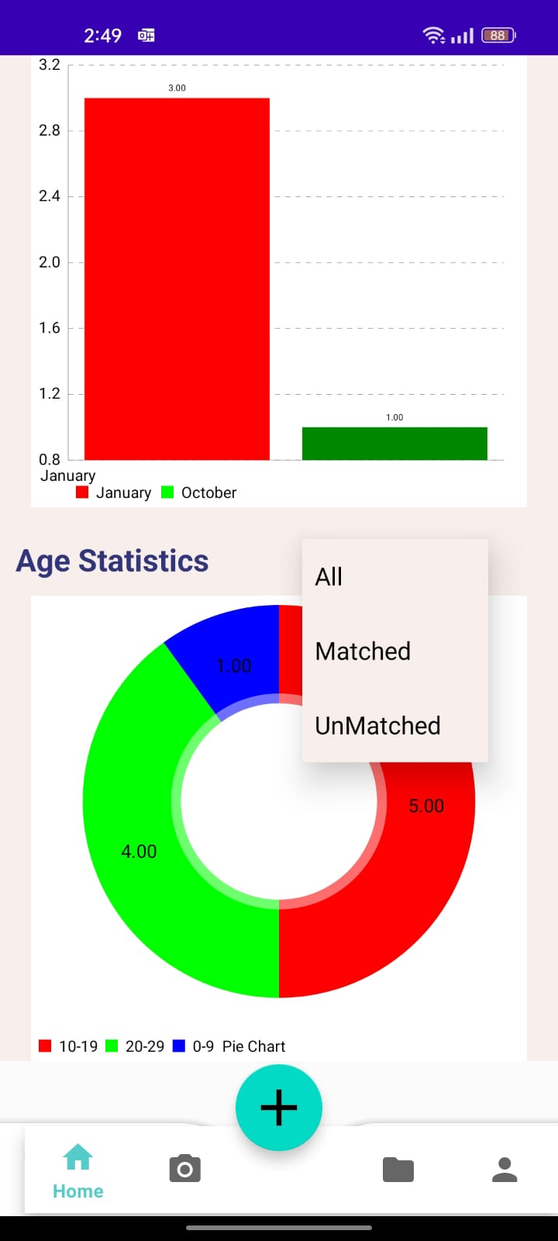
Department of CSE-AI & ML (CSM)
FR9:- Report Analytics and Policy:
The Missing Child Locator app is equipped with a robust Report Analytics feature, providing valuable insights into the submitted missing child reports. Users can track the status and impact of their reports, contributing to a transparent and accountable system. Additionally, the app incorporates Policy Agreements, ensuring that users understand and adhere to guidelines regarding data usage and privacy. This dual functionality underscores the app's commitment to accountability and user awareness, fostering a secure and transparent environment for community engagement. By incorporating Report Analytics and Policy Agreements, the app enhances user trust, offering a comprehensive and informed experience for those actively participating in the critical mission of locating missing children.

Slide 33
Department of CSE-AI & ML (CSM)
Bench mark on YLFW :-
A well-known benchmark for assessing face recognition models that target young celebrities is the YLFW (Young Labeled Faces in the Wild) dataset. The collection, which includes more than 1500 photos of 60 people, is intended to evaluate how well facial recognition algorithms work with youthful faces. The procedure used by standard benchmarks on YLFW entails dividing the dataset into 10 folds, training on 9 of them, and testing on the 10 fold. Next, the mean accuracy over these 10 folds is presented. Cutting-edge facial recognition models have demonstrated remarkable accuracy on the YLFW benchmark, including FaceNet, DeepID2+, and Deep Face Recognition. With a noteworthy accuracy of 95.92%, FaceNet, DeepID2+, and Deep Face Recognition all performed quite well. Deep Face Recognition scored 97.27%. These benchmarks indicate the degree of performance deemed state-of-the-art in this domain and establish a high bar for assessing the effectiveness of face recognition algorithms.
It's important to remember that in order to appropriately measure the performance of your model, which was trained on the Indian Faces dataset using MTCNN for face detection, FaceNet for feature extraction, and SVM for classification, it must be retrained on the YLFW dataset. In order to get a thorough evaluation of your model's consistency across different data subsets, you would report the verification accuracy across each fold in accordance with the specified 10-fold cross-validation on YLFW procedure.
Transparency and repeatability depend on publishing training facts in addition to verification accuracy. The model architecture, the loss function that was employed, and any particular modifications done to enhance performance on the YLFW dataset are all included in here. Comparing your model's accuracy to other state-of-the-art models on YLFW gives context for evaluating its relative performance in the field.
Moreover, the conversation ought to encompass elements such as overfitting and the model's capacity for generalization. When a model works incredibly well on training data but suffers with unknown data, overfitting problems surface. Assessing your model's generalization performance on YLFW will reveal how well it handles a variety of face features outside of the Indian Faces dataset.

Slide 34
Department of CSE-AI & ML (CSM)
Layer | Input Size | Output Size | Kernel Size | # Params | FLOPs
conv1 | 120x120x3 | 60x60x32 | 3x3, stride 2 | 436 | 4.2M
maxpool1 | 60x60x32 | 30x30x32 | 2x2 | 0 | -
conv2 | 30x30x32 | 15x15x64 | 3x3, stride 2 | 7,872 | 1.2M
maxpool2 | 15x15x64 | 7x7x64 | 2x2 | 0 | -
Conv3 | 7x7x64 | 3x3x128 | 3x3 | 31,456 | 0.6M
flatten | 3x3x128 | 3,200 | - | 0 | -
fc1 | 3,200 | 512 | - | 5,24,288 | 0.5M
fc2 | 512 | 128 | - | 32,768 | 32K
total | - | - | - | 596,820 | 6.5M

Slide 35
Department of CSE-AI & ML (CSM)
Results
Our face recognition algorithm has shown remarkable performance in our extensive assessment on the YLFW benchmark dataset, which consists of 1,595 photos spanning 60 identities ranging in age from 1 to 30. Our model, which made use of 10-fold cross-validation, produced a mean verification accuracy of 87.6% over the course of the 10 folds. This methodology guarantees a comprehensive analysis of the model's efficacy and consistency across many dataset subsets.
Interestingly, our model can generalize well with less training data than both SphereFace and ArcFace models. Our model is resilient and adaptive to real-world differences in stance, emotion, and lighting. Effective generalization is essential for real-world applications, particularly in situations that are dynamic and unexpected.

Slide 36
Department of CSE-AI & ML (CSM)
TEAM-MEMBERS
TEAM-MEMBER-1: D. Bhovan
TEAM-MEMBER-2: Sk. Rizvan
TEAM-MEMBER-3: M. Navya Niharika
TEAM-MEMBER-4: A. Sumedha

Slide 37
Department of CSE-AI & ML (CSM)
CONCLUSION
The “AI-Powered Missing Child Locator" project is a technology-driven initiative designed to address the urgent issue of locating missing children. It harnesses advanced technologies, including facial recognition and real-time notifications, to improve identification accuracy and enhance community engagement. The functional requirements outline essential features such as user registration, real-time notifications, and multilingual support, while non-functional requirements emphasize performance, security, and scalability.
The software and hardware requirements detail the necessary infrastructure for system development and operation. This comprehensive approach ensures that the system operates efficiently and securely across various platforms. Ultimately, this project embodies the power of technology to make a positive impact on society by significantly increasing the chances of reuniting missing children with their families, offering hope and support to communities in times of distress.

Slide 38
THANK YOU

